Slide 1
Chiba Campaign 2019 12.2 Report
DAIYAJIE

Slide 2
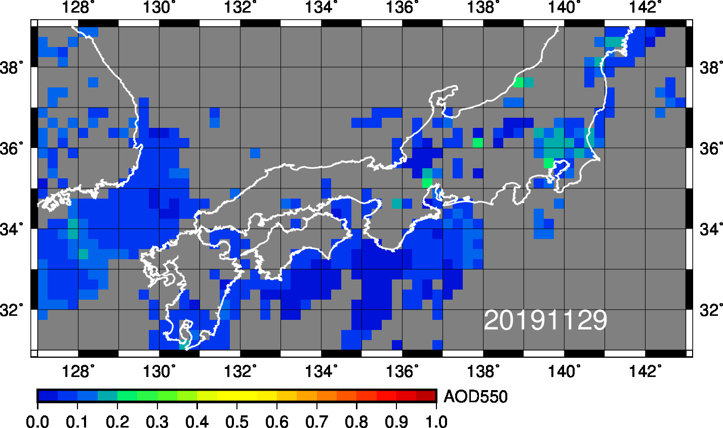
MODIS (11/29)

Slide 3
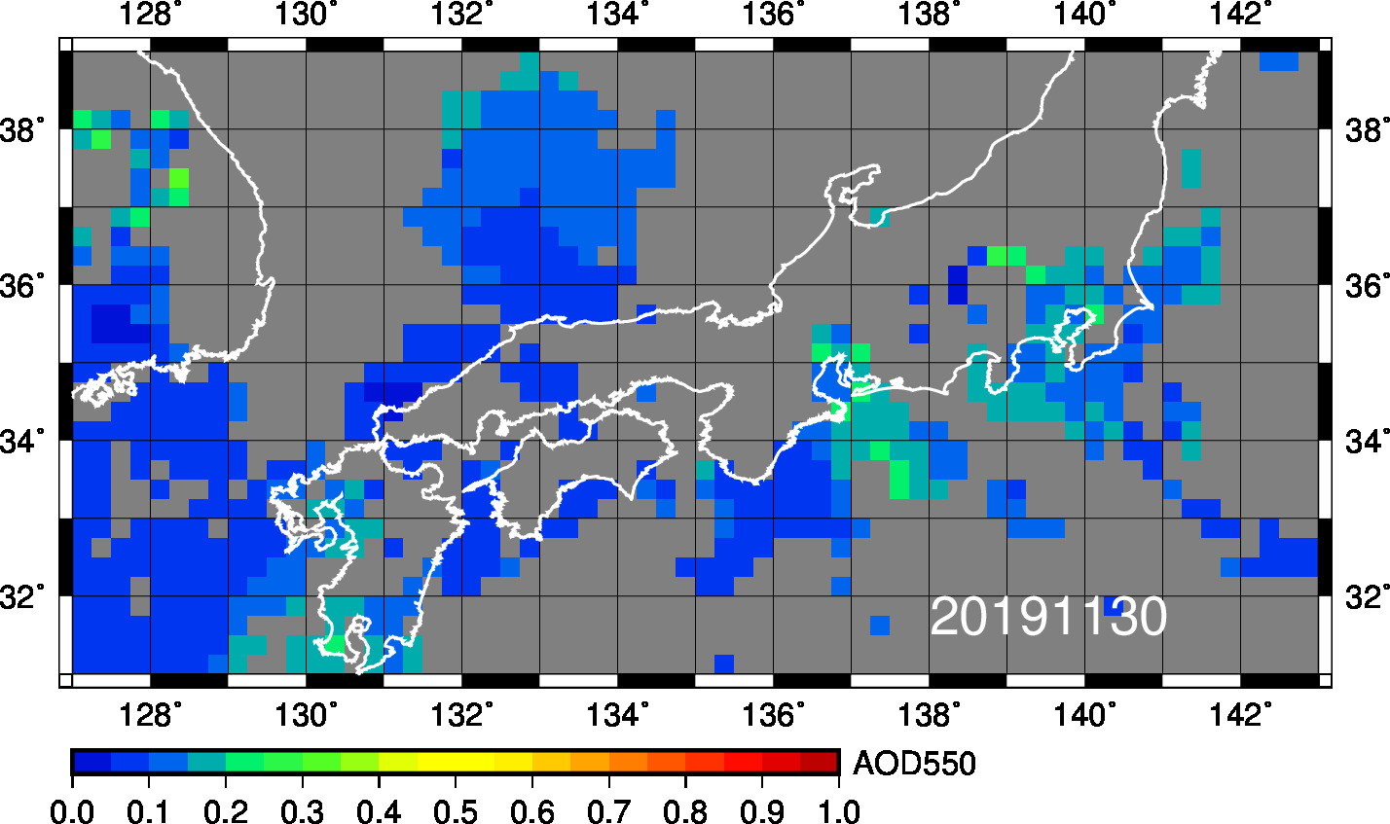
MODIS (11/30)

Slide 4
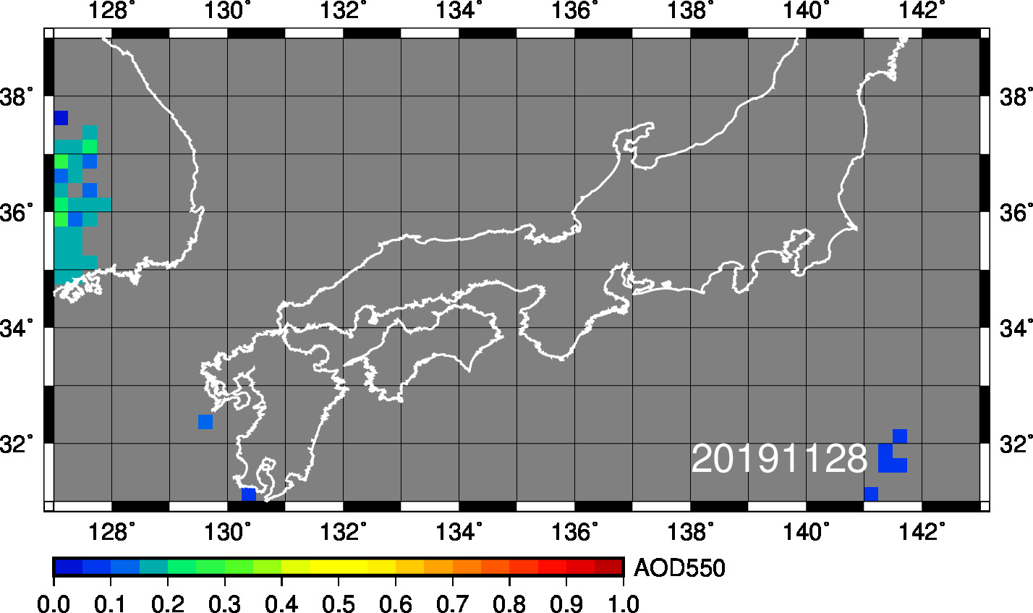
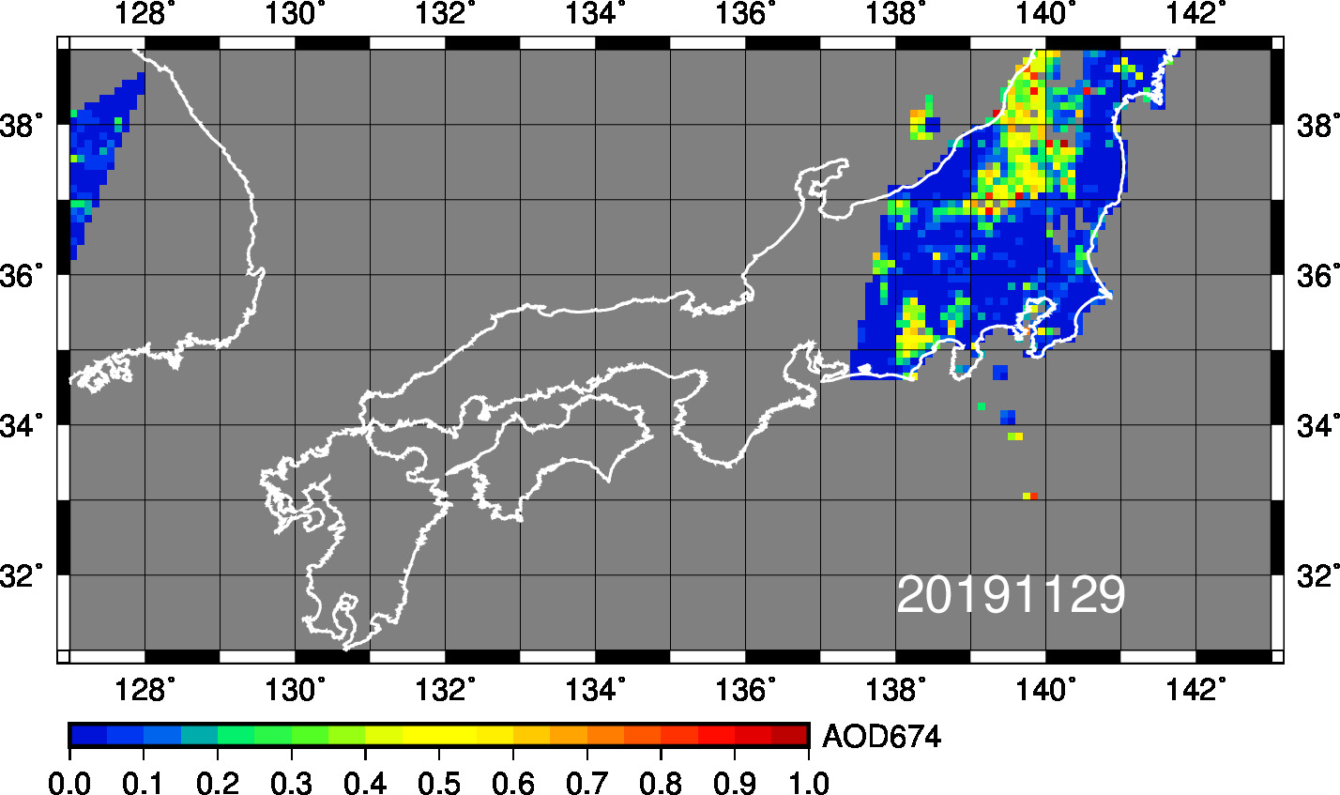
GCOM-C (11/29)

Slide 5
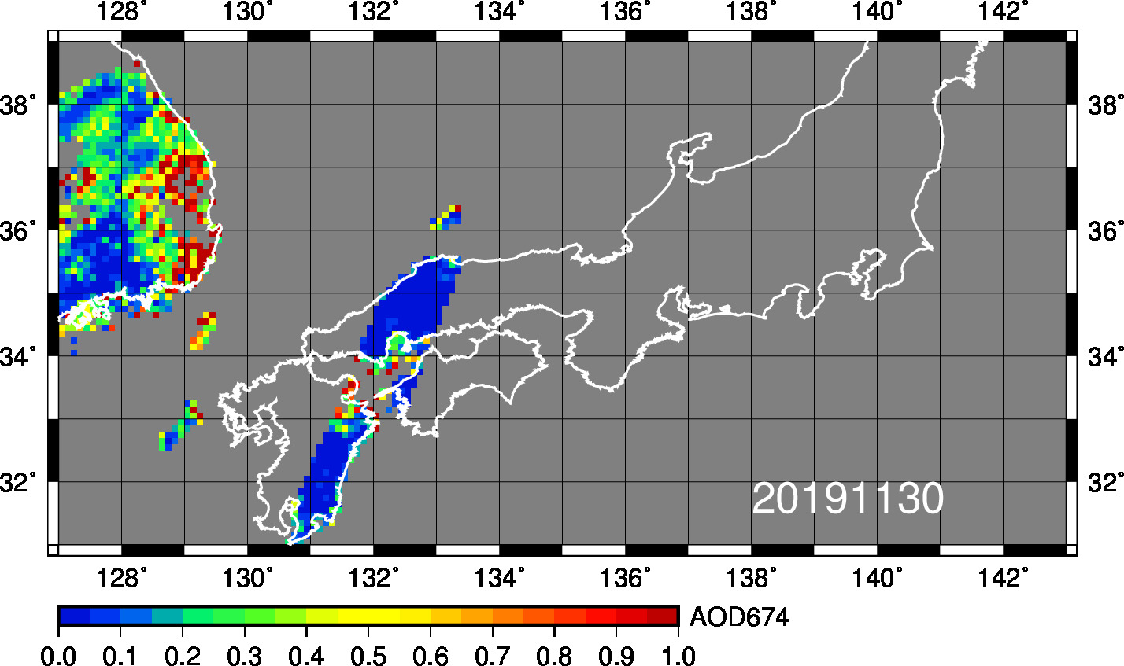
GCOM-C (11/30)

Slide 6
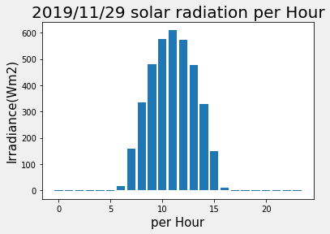
Figure:The average of Solar Irradiance per hour was observed at chiba university

Slide 7
Figure:The average of Solar Irradiance per hour was observed at chiba university

Slide 8
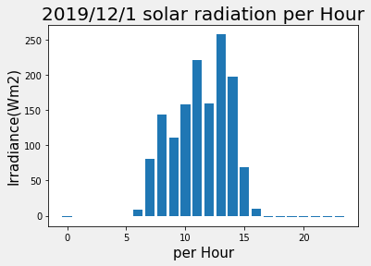
Figure:The average of Solar Irradiance per hour was observed at chiba university

Slide 9
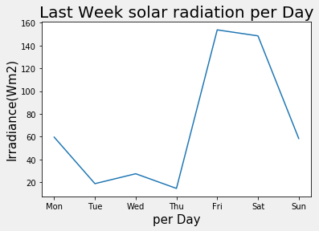
Figure:The average of Solar Irradiance per hour was observed at chiba university

